Slide 1



Spotify
Unwrapped
Kailin Xing

Slide 2


AGENDA
1
Introduction
2
Summary
3
Home
4
Playlist-based Recommendation
5
Perceptron
6
Song-based Recommendation
7
Artist Analysis

Slide 3


HELLO
Spotify UnWrapped was initiated because of the one's boredom with existing music that one has been listening to.
In hopes of discovering new music and finding the joy of listening to music, the application was started.

Slide 4



SUMMARY
5 Pages:
Home page with descriptions of the app
Explore page with top songs page
Spotify Playlist Recommendation page
Song Based Recommendation page
Artist Analysis Page

Slide 5


Streamlit
TOOLS AND
SOFTWARE
Pandas
NumPy
SpotiPy
PlotLy
Scikit-learn

Slide 6

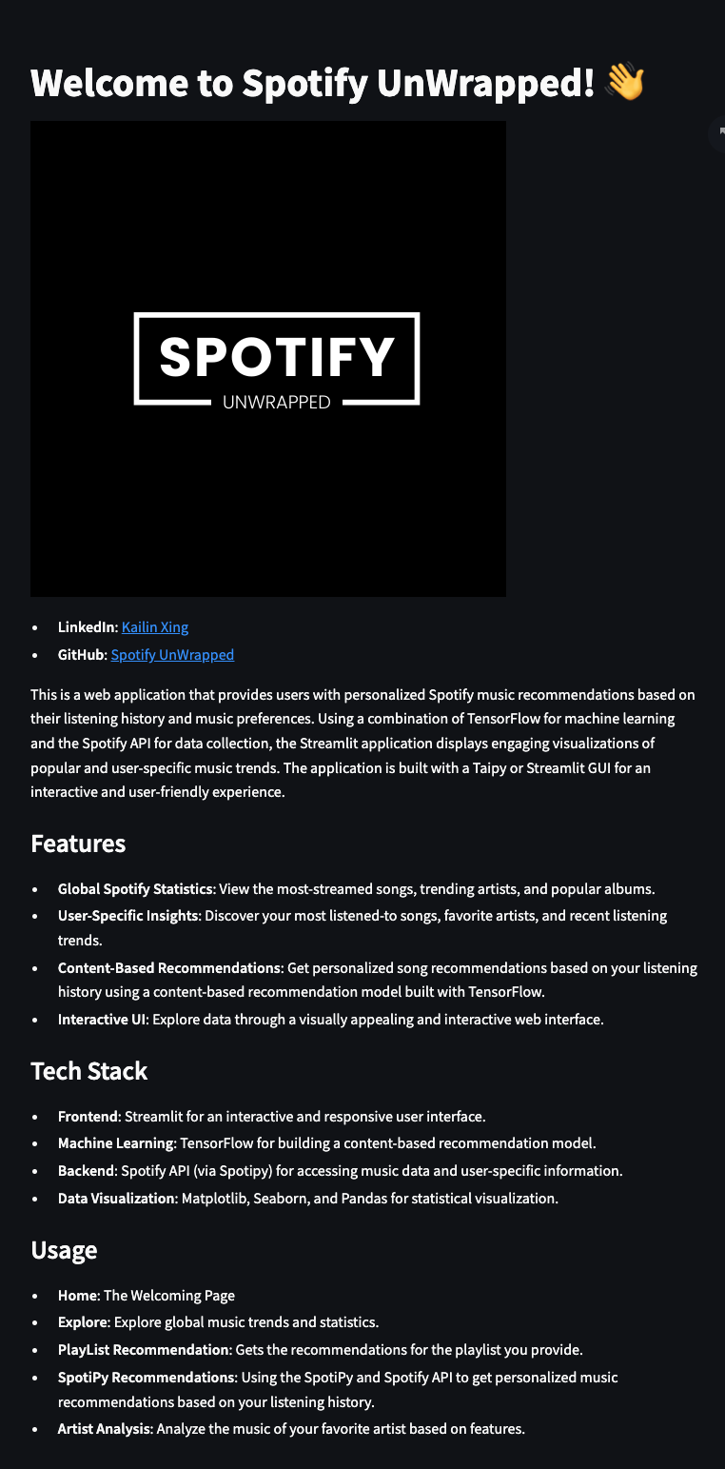

Home

Slide 7

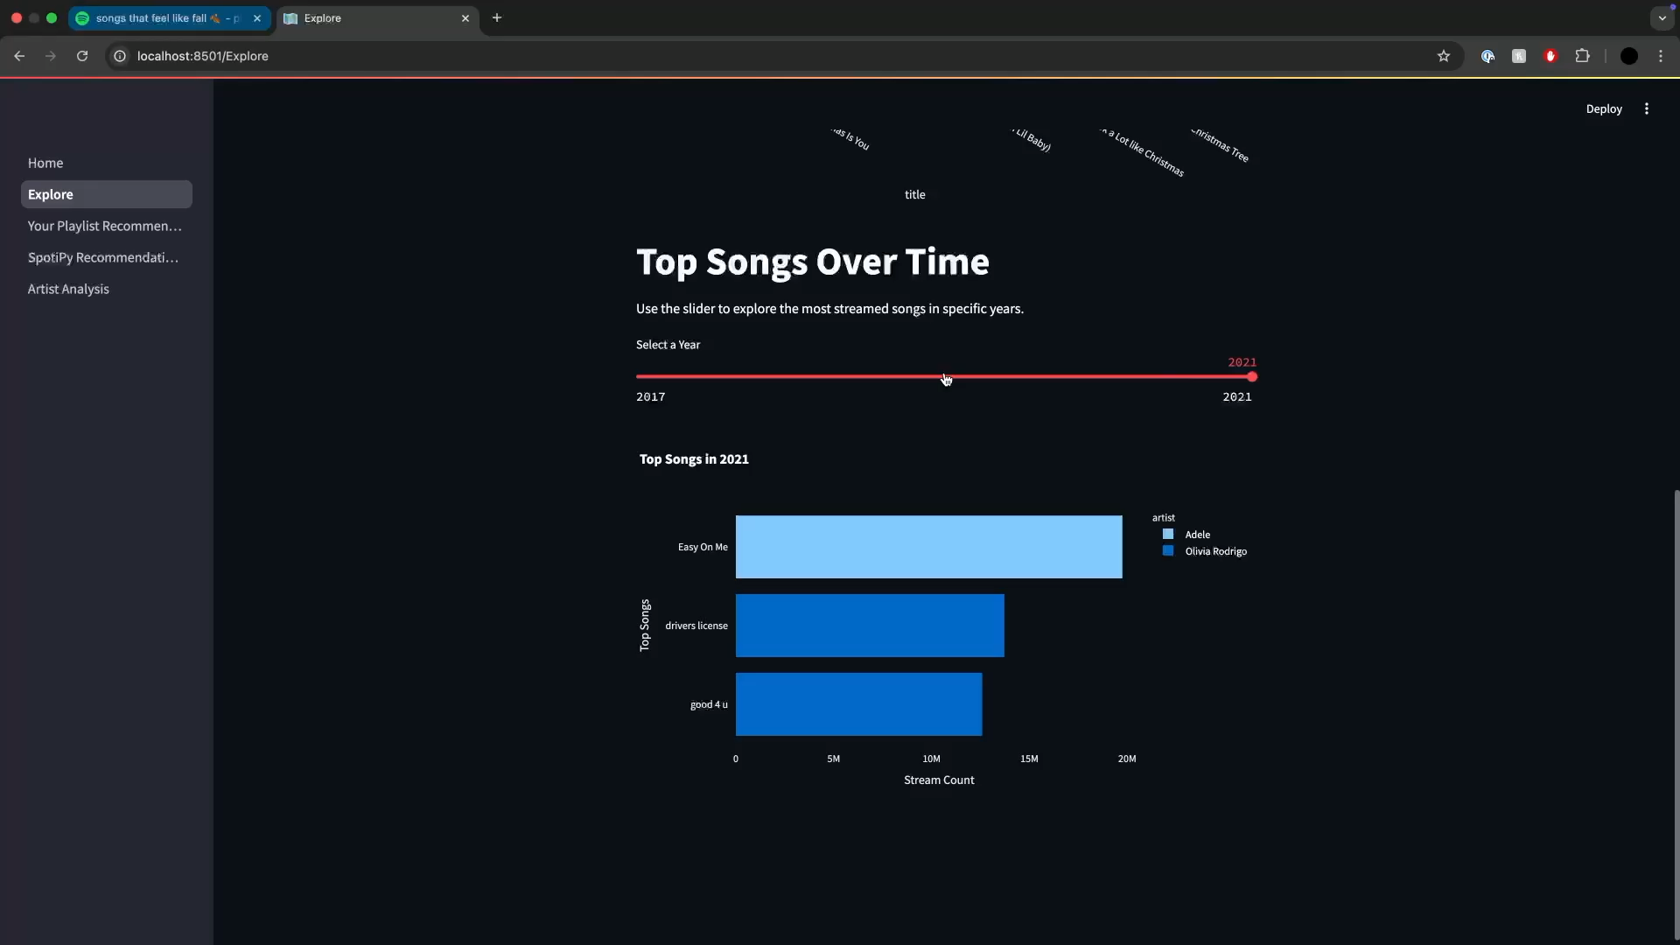
Playlist-based Recommendation

Slide 8


Perceptron
What is it?
A supervised learning algorithm for binary classification
Input: feature vectors (e.g., tempo, energy).
Weights are applied to each feature.
Iteration using weighted inputs through activation function to classify.
Output is binary (e.g., match (1) or no match (0)).

Slide 9


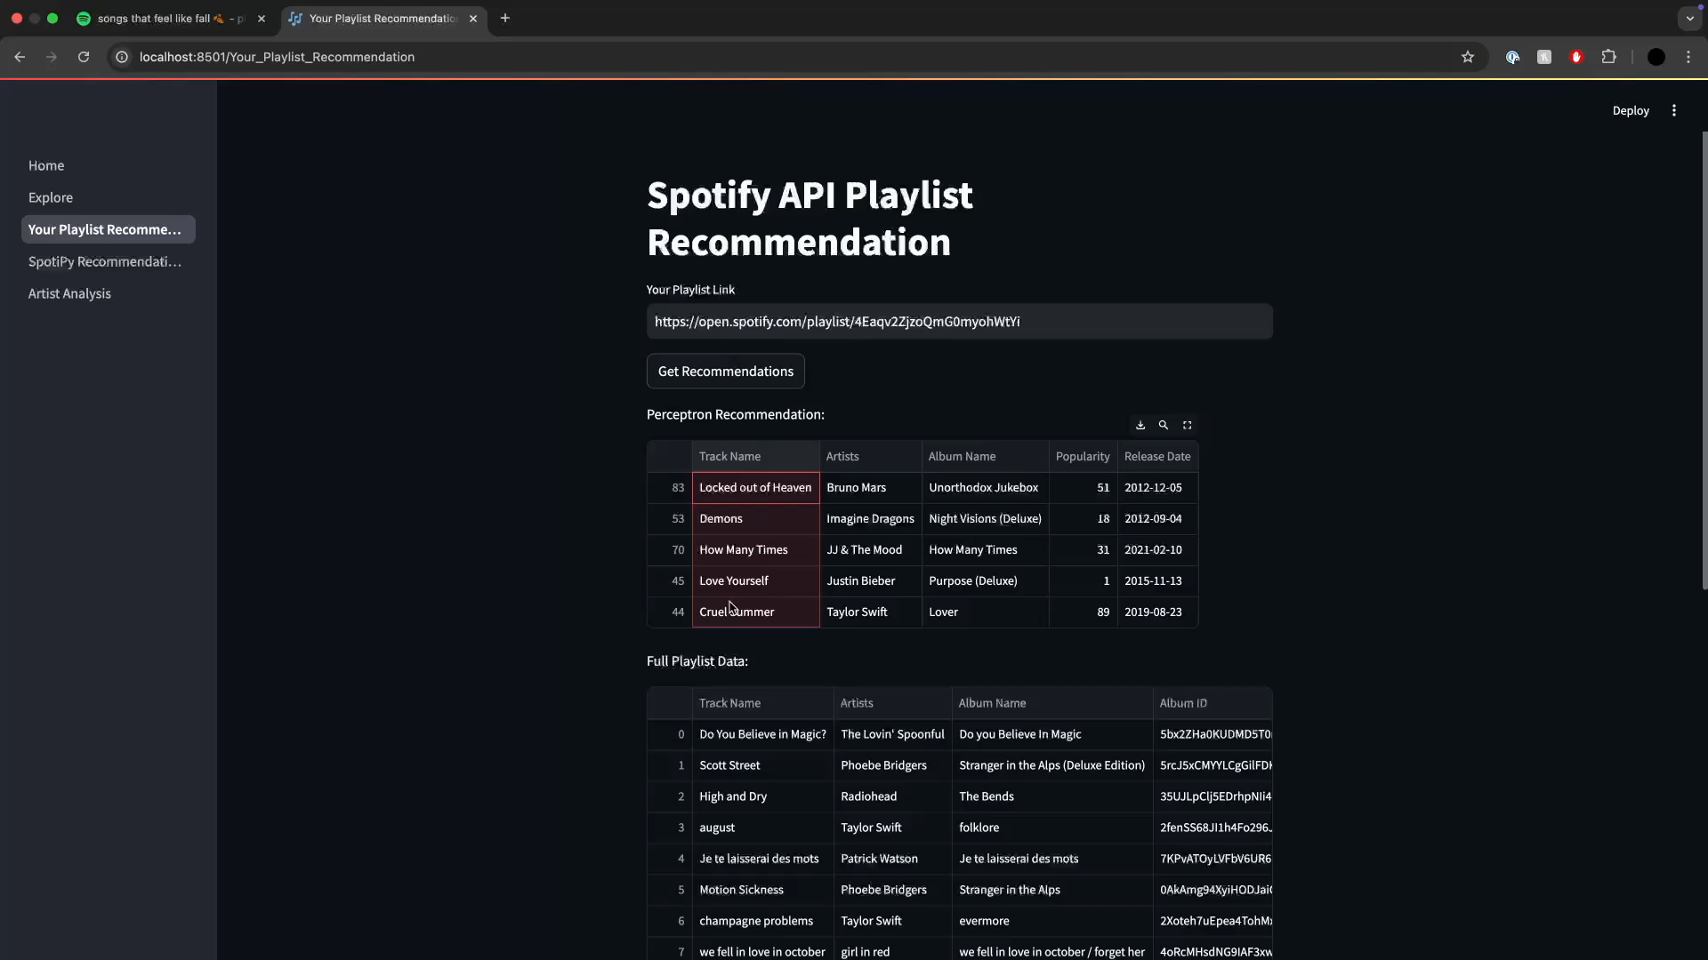

Song based Recommendation

Slide 10


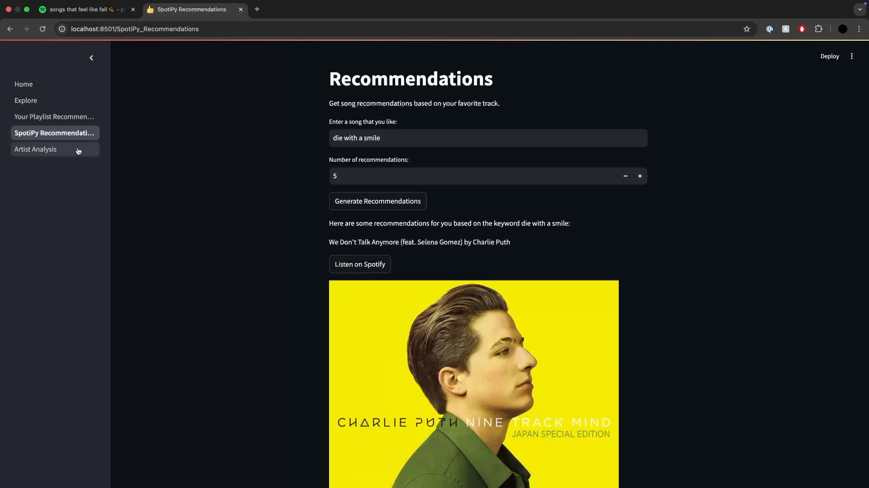
Artist Analysis

Slide 11
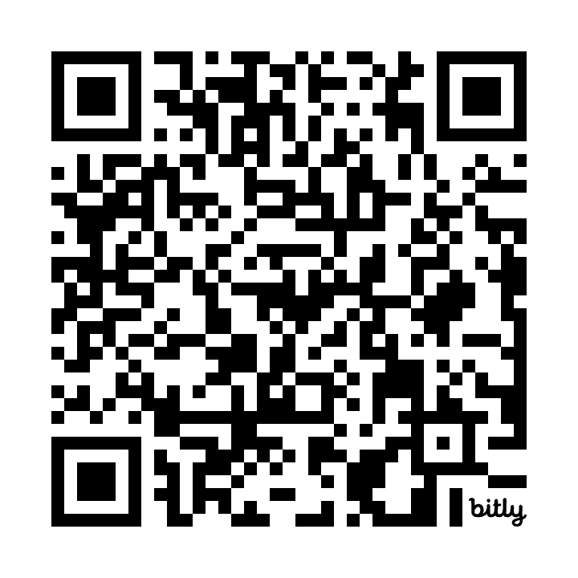
Try it out yourself ☺
bit.ly/SpotifyUnWrapped

